Slide 1
Employee Attrition Prediction Using
Deep Learning
By
Madhan Shankar G
220701149
Guide
DR. V. AUXILIA OSVIN NANCY MTech.., Phd..,

Slide 2
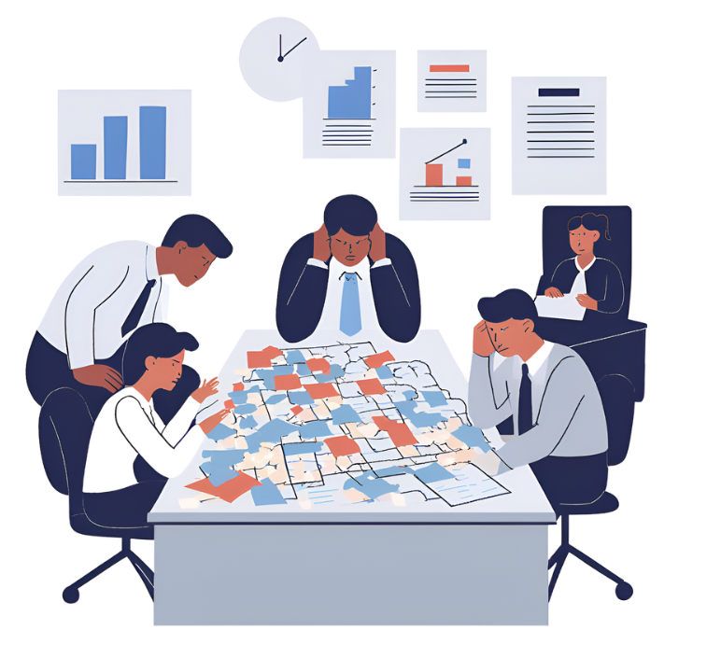
INTRODUCTION
Employee attrition refers to the gradual reduction in workforce when employees leave and are not replaced.
High attrition disrupts business operations, increases hiring and training costs, and reduces organizational efficiency.
Traditional HR methods are reactive, relying on exit interviews and historical records.
Predictive analytics with machine learning and deep learning offers proactive identification of at-risk employees.
This project applies a Feedforward Neural Network (FNN) model on structured HR datasets to forecast attrition risk and recommend early interventions.

Slide 3
OBJECTIVES
The Main Objectives of the Project involves:
Predict Employee Attrition using a deep learning-based Feedforward Neural Network (FNN).
Analyze key factors like job satisfaction, salary, career growth, and performance.
Handle class imbalance with Synthetic Minority Oversampling Technique (SMOTE).
Provide real-time insights through an interactive, user-friendly HR dashboard.
Enhance employee retention by enabling proactive, data-driven decisions.

Slide 4
LITERATURE SURVEY
Author(s) | Year | Contribution | Remarks | Publications
Chen & Park | 2022 | Introduced ANN for attrition prediction with dropout and regularization. | Achieved 90%+ accuracy but lacked deployment features and interpretability. | International Journal of AI Research (Vol. 8, No. 2)
Nguyen, Kumar & Sahu | 2023 | Applied Random Forest and Gradient Boosting models for workforce churn prediction. | Outperformed Logistic Regression but struggled with explainability. | Proceedings of IEEE ICMLA (Vol. 11)
Gupta & Basu | 2025 | Developed a deep learning HR system using batch normalization and real-world datasets. | Discussed future integration with business intelligence tools for strategic retention planning. | Journal of Data Science & AI (Vol. 13, No. 1)

Slide 5
LITERATURE SURVEY
Author(s) | Year | Contribution | Remarks | Publications
Zhang et al. | 2024 | Investigated sensitive attrition scoring using advanced neural networks with improved feature selection methods. | Reported higher classification accuracy with strategic feature optimization. | IEEE Transactions on Computational Intelligence (Vol. 16, No. 2)
Abadi et al. | 2023 | Showcased TensorFlow’s capabilities for scalable deep learning applications in HR analytics. | Emphasized fast deployment and model tuning. | Journal of Software Engineering (Vol. 10, No. 4)
Sharma & Thomas | 2024 | Highlighted the importance of Explainable AI using SHAP to improve HR interpretability. | Useful for larger setups, but complex for small enterprises. | International Conference on AI for Business (ICAB 2024)

Slide 6
LITERATURE SURVEY
Author(s) | Year | Contribution | Remarks
Chollet | 2024 | Demonstrated practical deep learning applications with Keras for tasks like attrition prediction. | Provided foundational techniques relevant to this project’s model development.
Zhang et al. | 2024 | Investigated sensitive attrition scoring using advanced neural networks with improved feature selection methods. | Reported higher classification accuracy with strategic feature optimization.
Williams & Patel | 2023 | Proposed an ensemble stacking model combining decision trees and deep learning for HR attrition forecasting. | Achieved improved accuracy and reduced overfitting, but lacked built-in HR policy recommendation features.

Slide 7
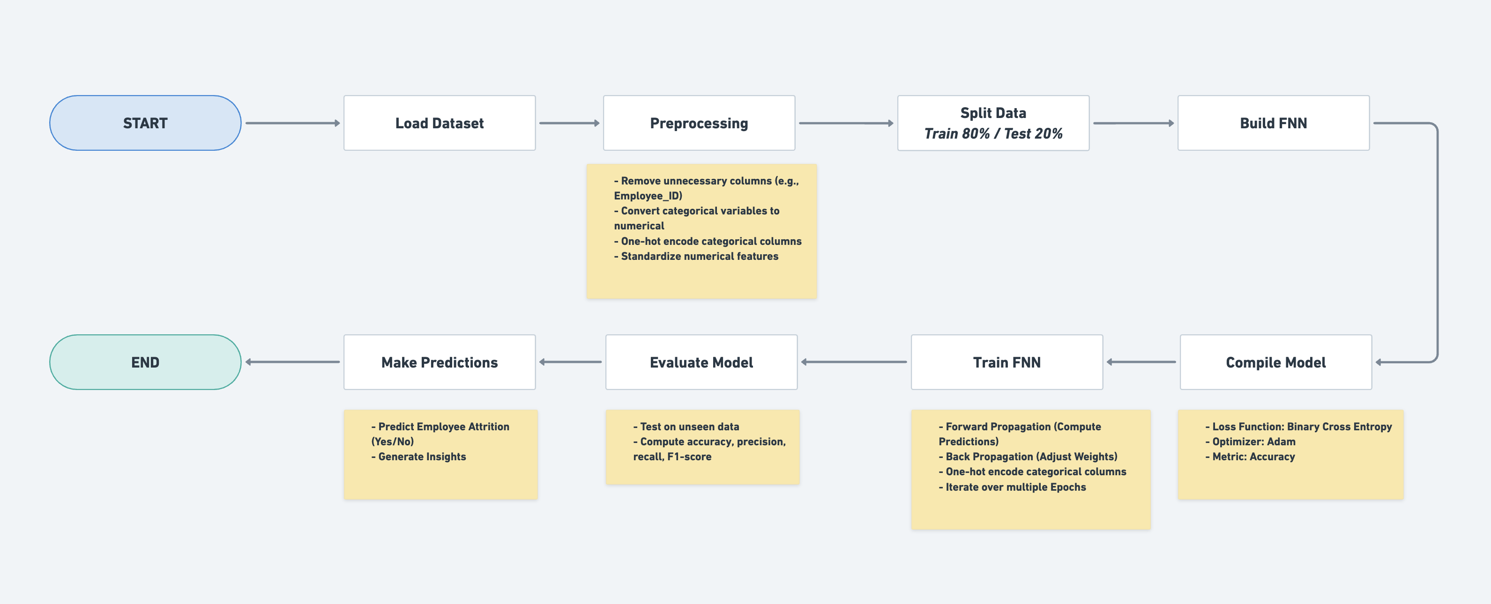
SYSTEM ARCHITECTURE

Slide 8
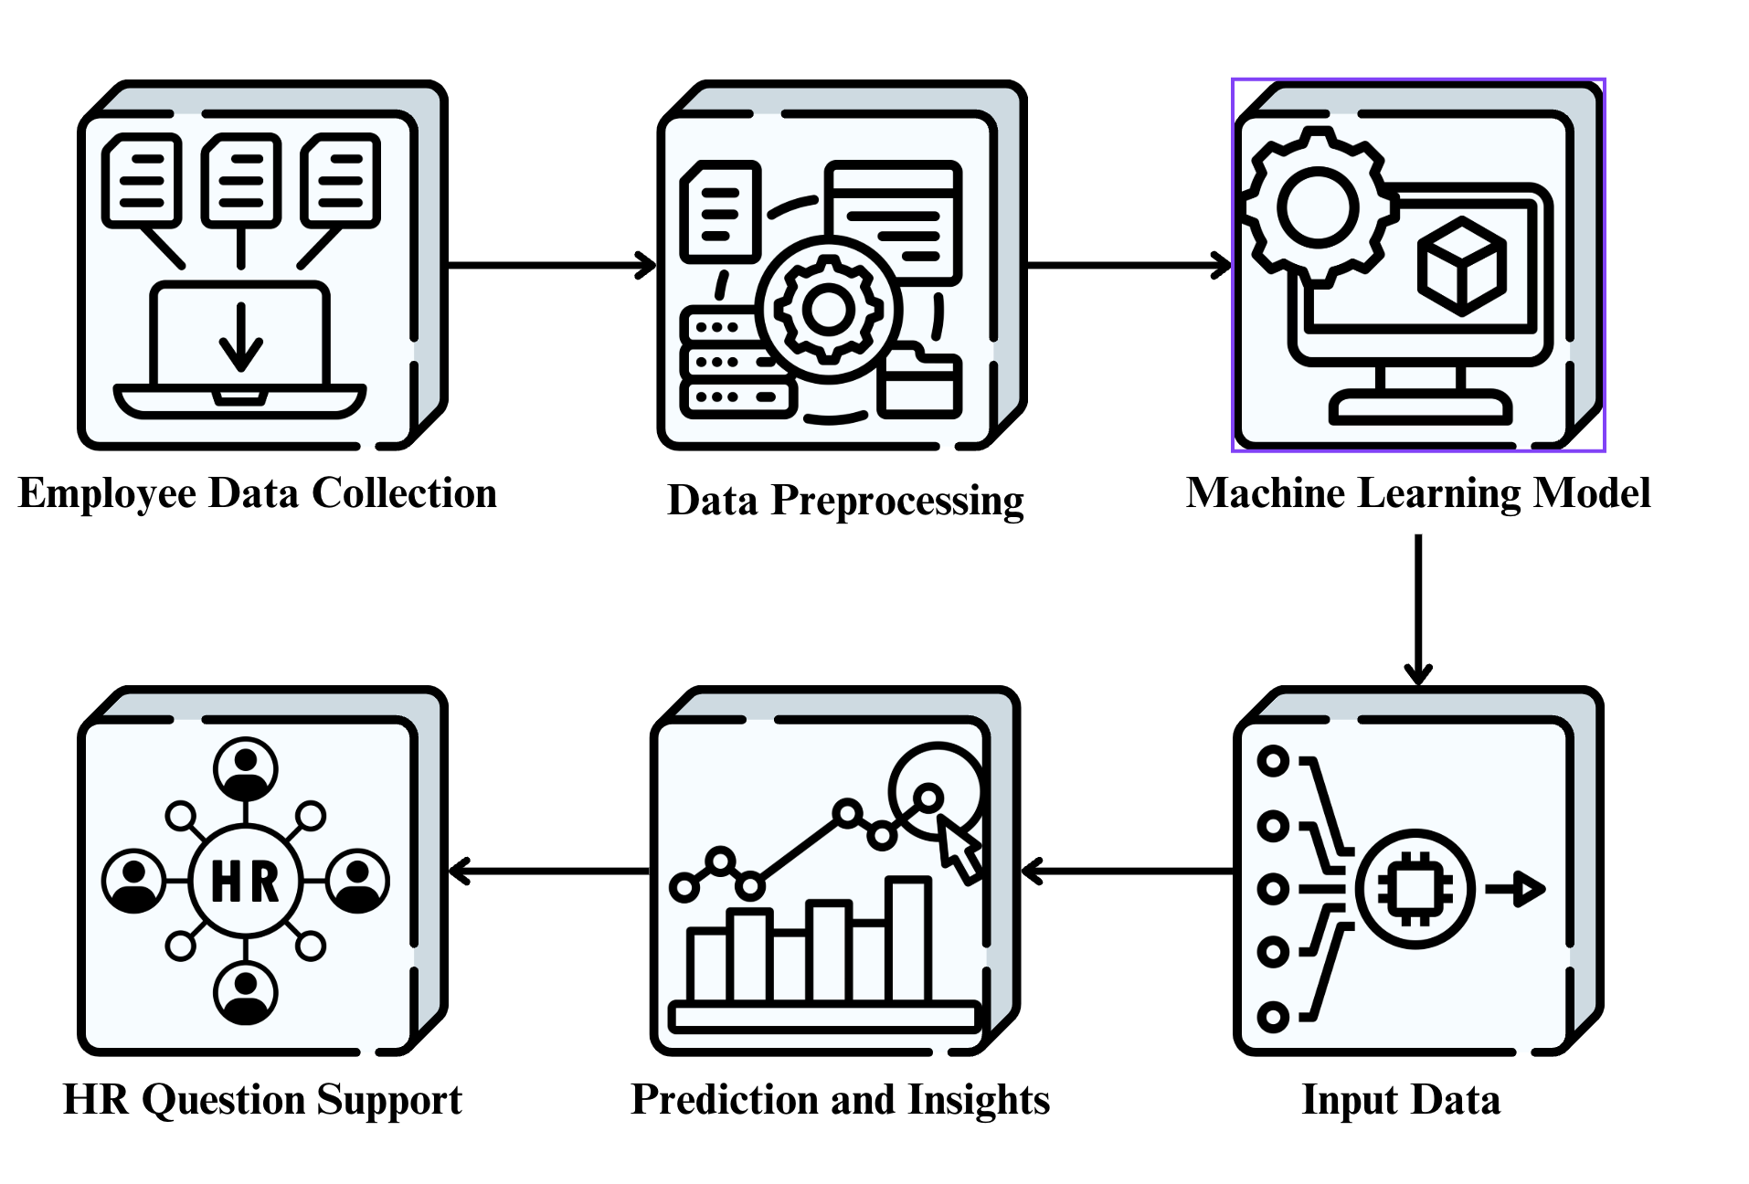
METHODOLOGY
Dataset includes 15+ HR attributes — job role, salary, job satisfaction, overtime, work-life balance.
Missing values imputed using median for numerics and mode for categoricals.
Outliers detected with boxplots & Z-score, handled by removal/capping.
One-Hot Encoding applied to convert categorical data into numerical.
All numeric features standardized using Z-score normalization.
SMOTE technique used to handle class imbalance by oversampling minority cases.
Derived new features like experience levels and tenure categories to improve model learning.

Slide 9
METHODOLOGY
Model Development & Evaluation:
Selected model: Feedforward Neural Network (FNN) for handling non-linear data.
Architecture: Input layer, 2 hidden layers (ReLU), dropout, and sigmoid output.
Adam optimizer chosen for adaptive, efficient learning.
Binary Cross-Entropy loss function used for binary classification.
Data split into 80% training and 20% testing.
Model performance measured using Accuracy, Precision, Recall, F1-Score, ROC-AUC.
Grid Search performed to tune hyperparameters like neurons, dropout, and batch size.

Slide 10
IMPLEMENTATION
Tech Stack:
Python — core programming language.
Pandas & NumPy — data manipulation and numerical processing.
Scikit-learn — preprocessing, SMOTE, metrics.
TensorFlow/Keras — deep learning model development.
Matplotlib & Seaborn — data visualization libraries.
Jupyter Notebook — interactive coding platforms.
FNN Algorithm (MLP)
Why FNN?
- Best for capturing non-linear, multi-dimensional HR data relationships on a large scale dataset.

Slide 11
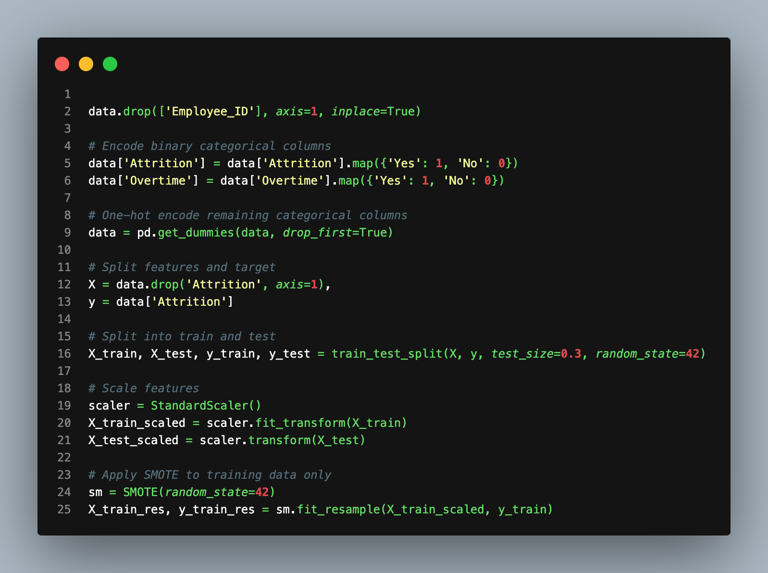
IMPLEMENTATION
Data Cleaning & Preprocessing with Pandas + SMOTE
Grid Search for Hyperparameter Tuning

Slide 12
IMPLEMENTATION
Model Performance Comparison Table:
Model is implemented on different algorithms to get the best suitable algorithm which is FNN.
Model | Accuracy | Precision | Recall | F1-Score | ROC-AUC
Logistic Regression | 88% | 0.81 | 0.74 | 0.77 | 0.85
Random Forest | 92% | 0.87 | 0.82 | 0.84 | 0.91
SVM | 90% | 0.83 | 0.78 | 0.80 | 0.89
FNN | 96% | 0.94 | 0.91 | 0.92 | 0.94

Slide 13
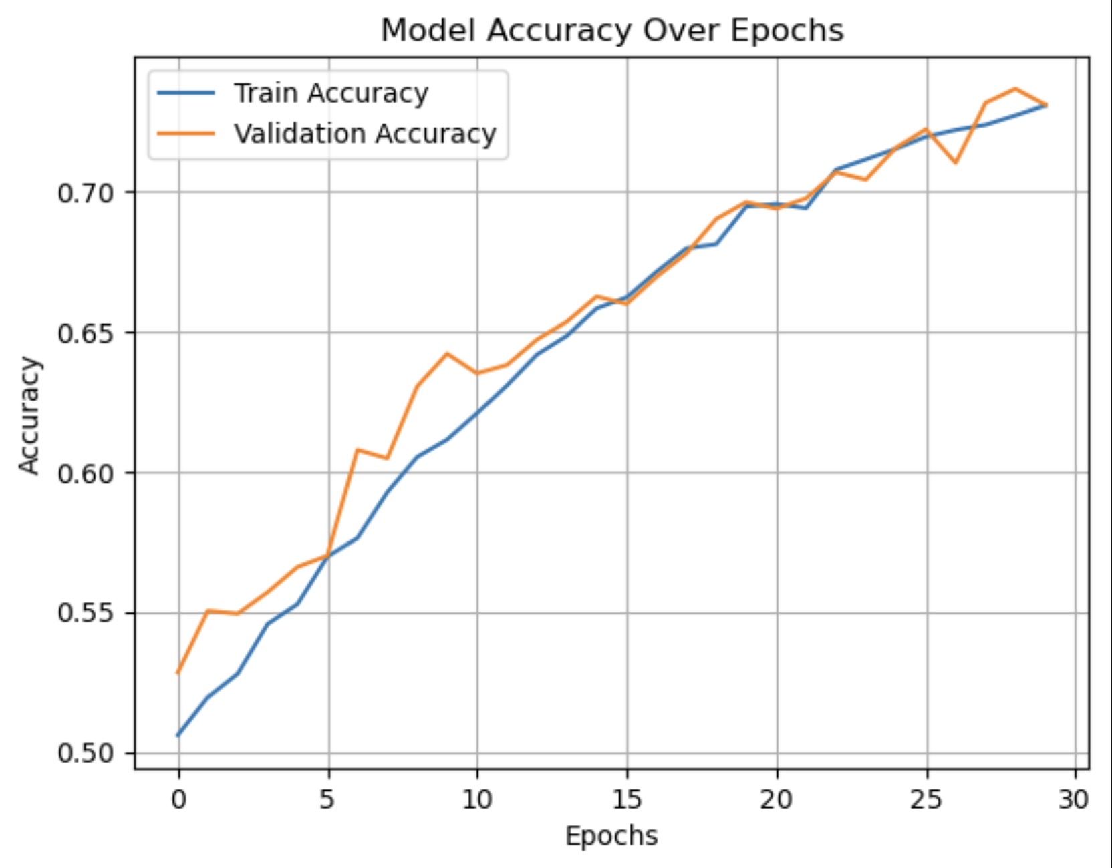
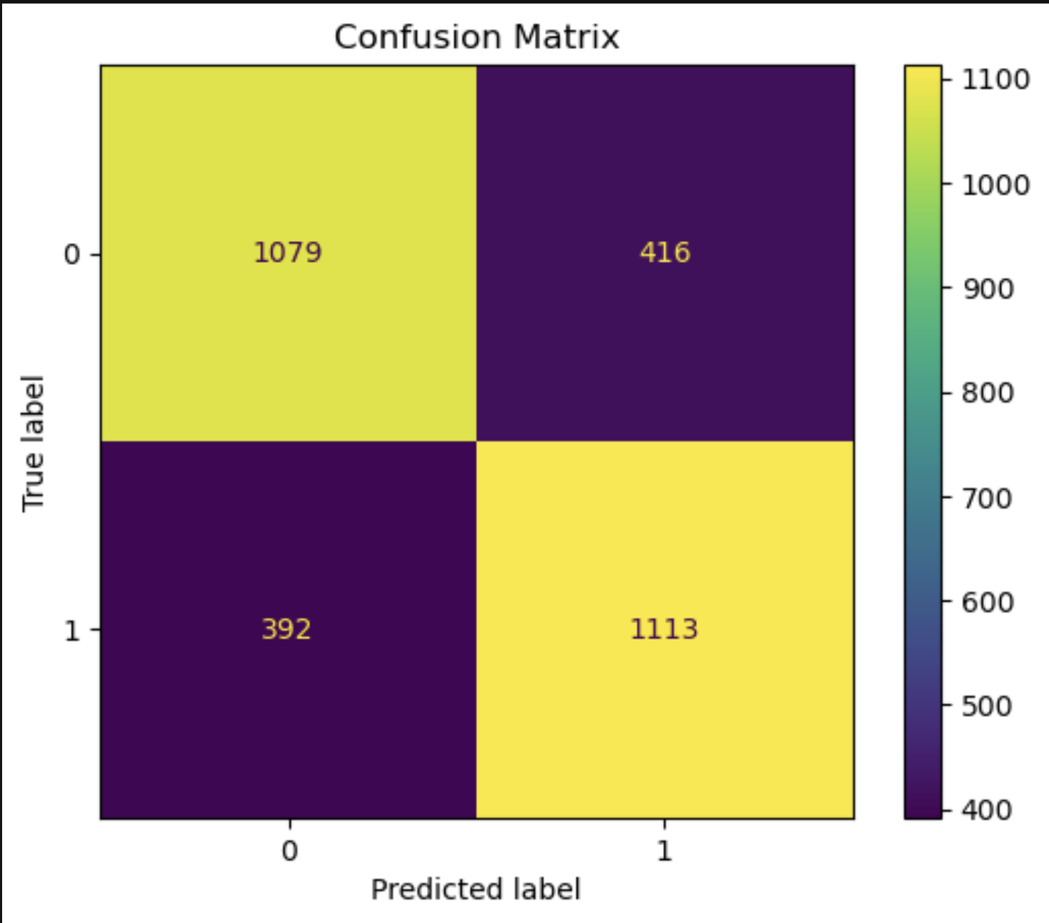
IMPLEMENTATION
Accuracy vs Epochs graph
Confusion Matrix heatmap
Accuracy plot confirms stable learning without overfitting
Confusion matrix validates classification balance

Slide 14
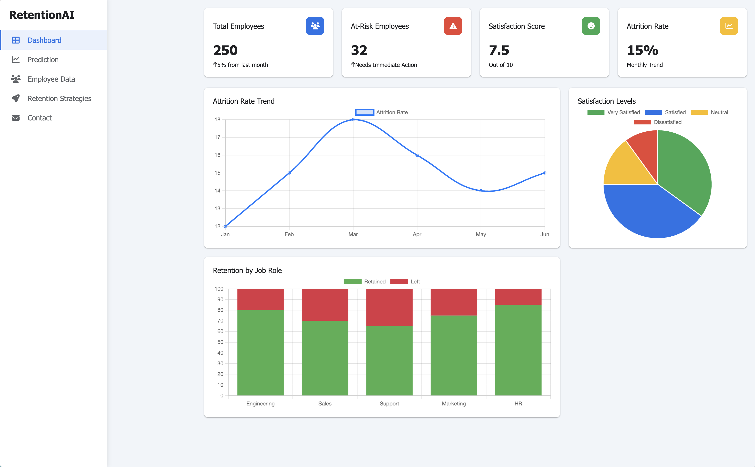
RESULTS
Website Dashboard :
Model integrated into a web-based dashboard.
Real-time risk predictions with color-coded risk bars.
Strategic HR recommendations like performance appraisals, salary reviews, or workload adjustments.
Department-wise attrition rates, monthly trends, and satisfaction distributions visualized.

Slide 15
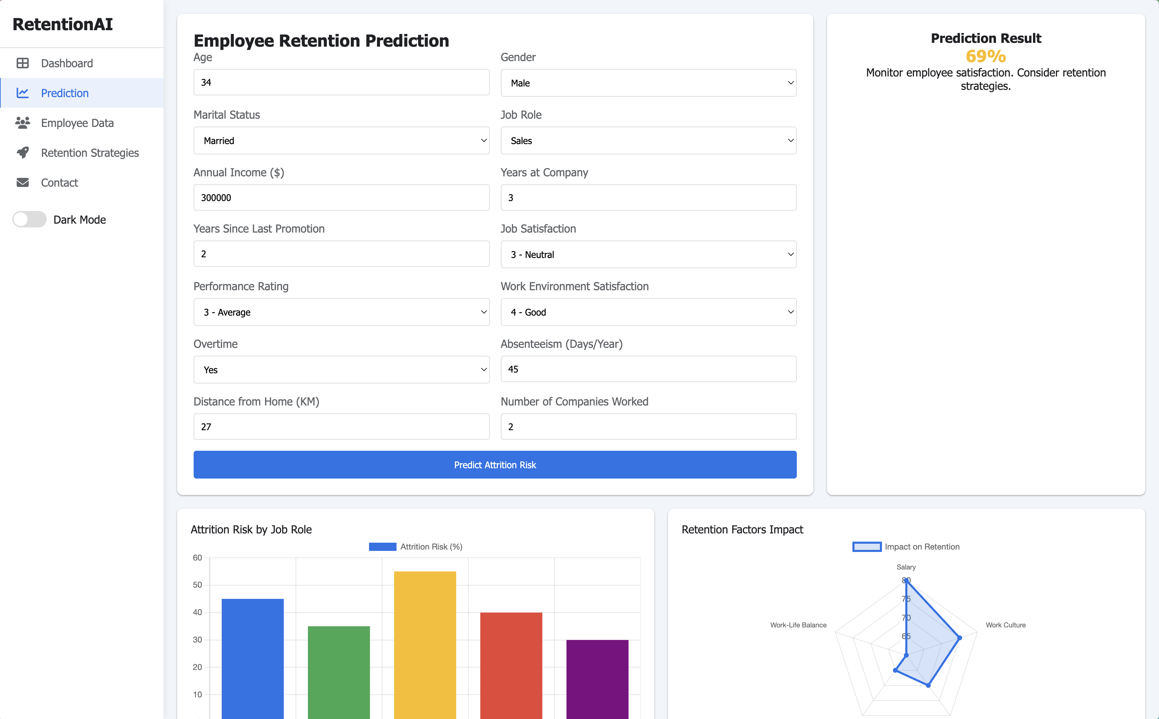
RESULTS
Prediction :

Slide 16
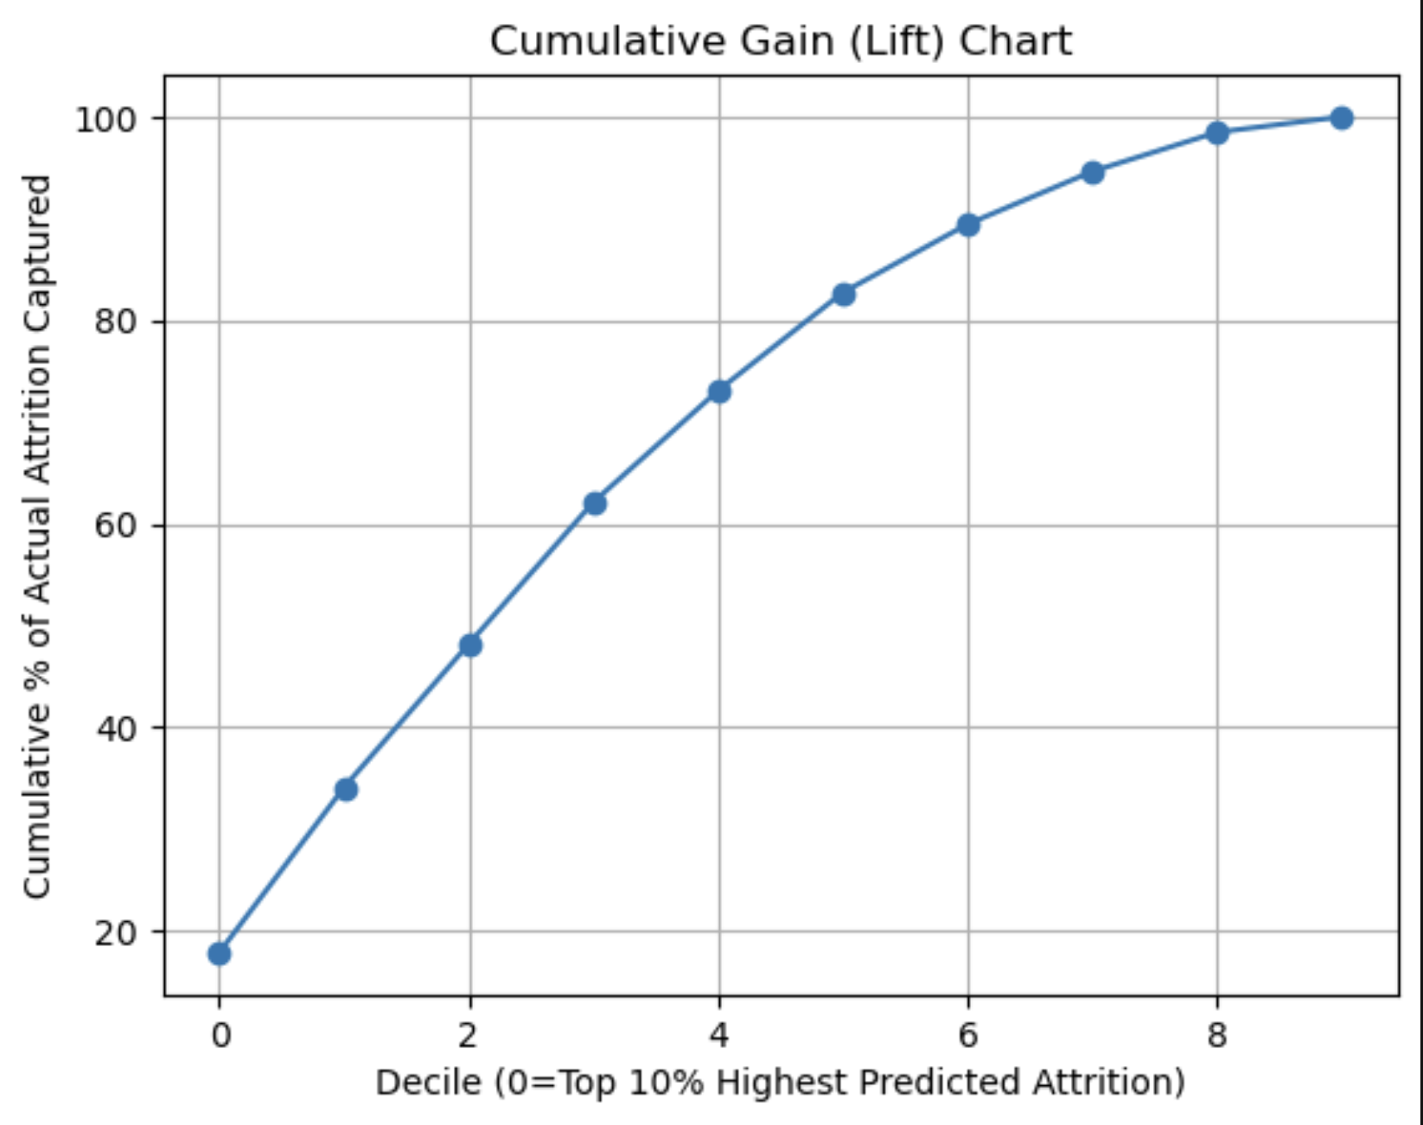
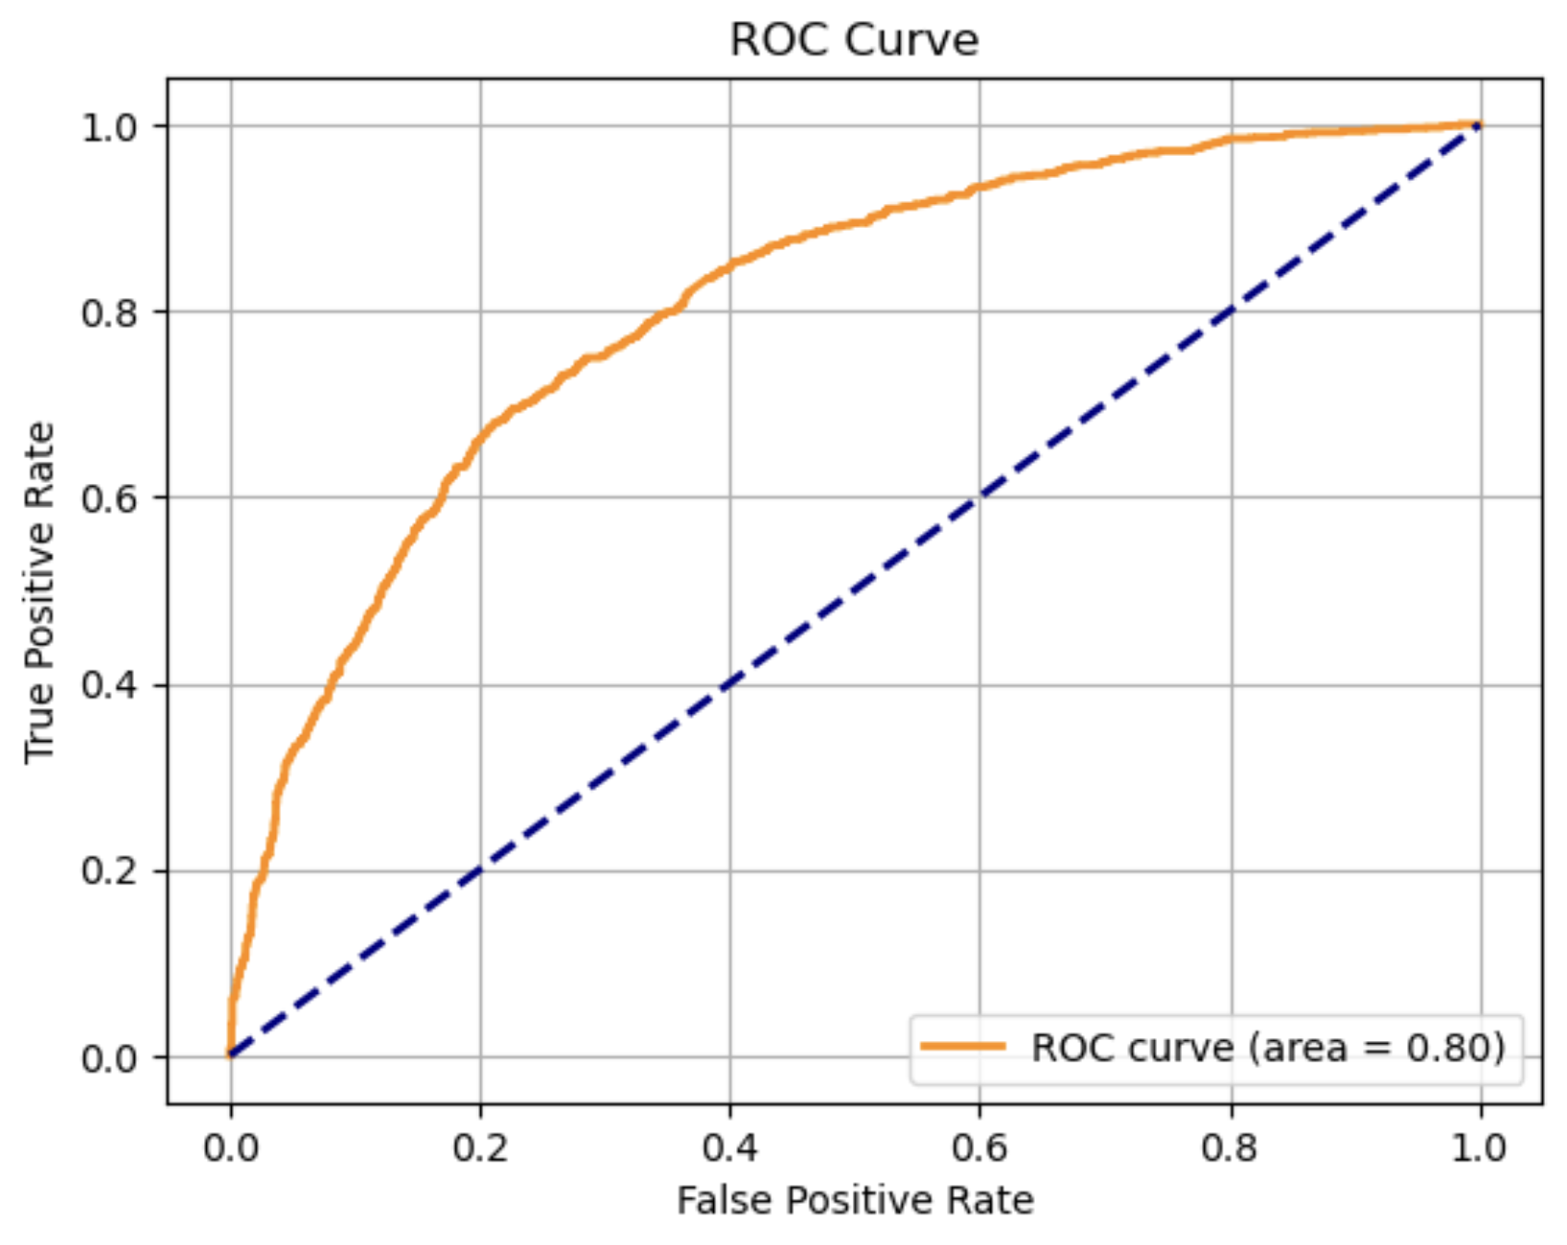
COMPARISON WITH EXISTING WORK
Aspect | Existing System | This Project (FNN Implementation)
Accuracy Range | 85% – 92% using ML models | 96% test accuracy — highest among compared models.
ROC-AUC Score | 0.85 – 0.91 | 0.94 ROC-AUC ensuring excellent classification capability.
Class Imbalance Handling | Mostly ignored or basic oversampling | SMOTE applied for balanced and fair model training.
Dashboard Integration | Rare in literature; static reports or none | Live HR dashboard with risk scores and actionable insights.
Interpretability Tools | Limited explainability, few using SHAP | Integrated feature importance analysis and risk breakdown.
Operational Deployment | Primarily academic prototypes, not used in companies | Web-based, real-time HR prediction and decision support tool.

Slide 17
Conclusion and Future Work
Conclusion
Deep learning-based attrition prediction achieved high accuracy and balanced performance.
The FNN model successfully identified high-risk employees with minimal false positives.
Predictive insights enable timely interventions before voluntary exits occur.
AI-enhanced HR analytics improves workforce stability and operational efficiency.
Future Work
Integrate sentiment analysis from employee surveys.
Include external job market indicators.
Test hybrid ensemble deep learning models.
Deploy as an enterprise-level HR analytics tool.

Slide 18
REFERENCES
[1] Chen, R., & Park, M. (2022). "Deep Learning Models for Predicting Employee Attrition: A Case Study." International Journal of Artificial Intelligence Research.
[2] Nguyen, T., Kumar, A., & Sahu, R. (2023). "Improving Workforce Retention with Machine Learning and Data Analytics." IEEE Transactions on Computational Social Systems.
[3] IBM Research Team (2023). "IBM HR Analytics Employee Attrition Dataset."
[4] Sharma, K., & Thomas, L. (2024). "Human Resource Analytics using Explainable AI: A Practical Guide." ACM HR Tech Conference Proceedings.
[5] Gupta, S., & Basu, M. (2025). "Predictive HR Systems: Deep Neural Networks in Workforce Management." Journal of Emerging Technologies in Data Science.
[6] King, J., & Reddy, A. (2022). "The Role of Data Science in Employee Lifecycle Management." Springer Human-Centered AI.
[7] Abadi, M., et al. (2023). "TensorFlow: A Framework for Machine Learning and Deep Learning in Practice."
[8] Chollet, F. (2024). Deep Learning with Python, 2nd Edition, Manning Publications.

Slide 19
THANK YOU

